Slide 1
Tic Tac Toe
The Best Two-Player
Board Game

Slide 2
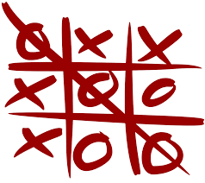
Strategy of wining game:
- X and O are player’s of this game
- X and O, who take turns marking the spaces in a 3×3 grid.
- The player who succeeds in placing three of their marks in a horizontal, vertical, or diagonal row is the winner.

Slide 3
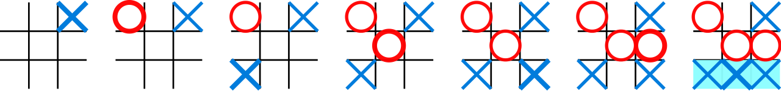
Ex:-
(1)
(2)
(3)
(4)
(5)
(6)
(7)
X-Won’s

